Slide 1

So.. How can we achieve better visualization of the jobs world using information exchange between jobseekers,Unemployment Office and Employers?

Slide 2
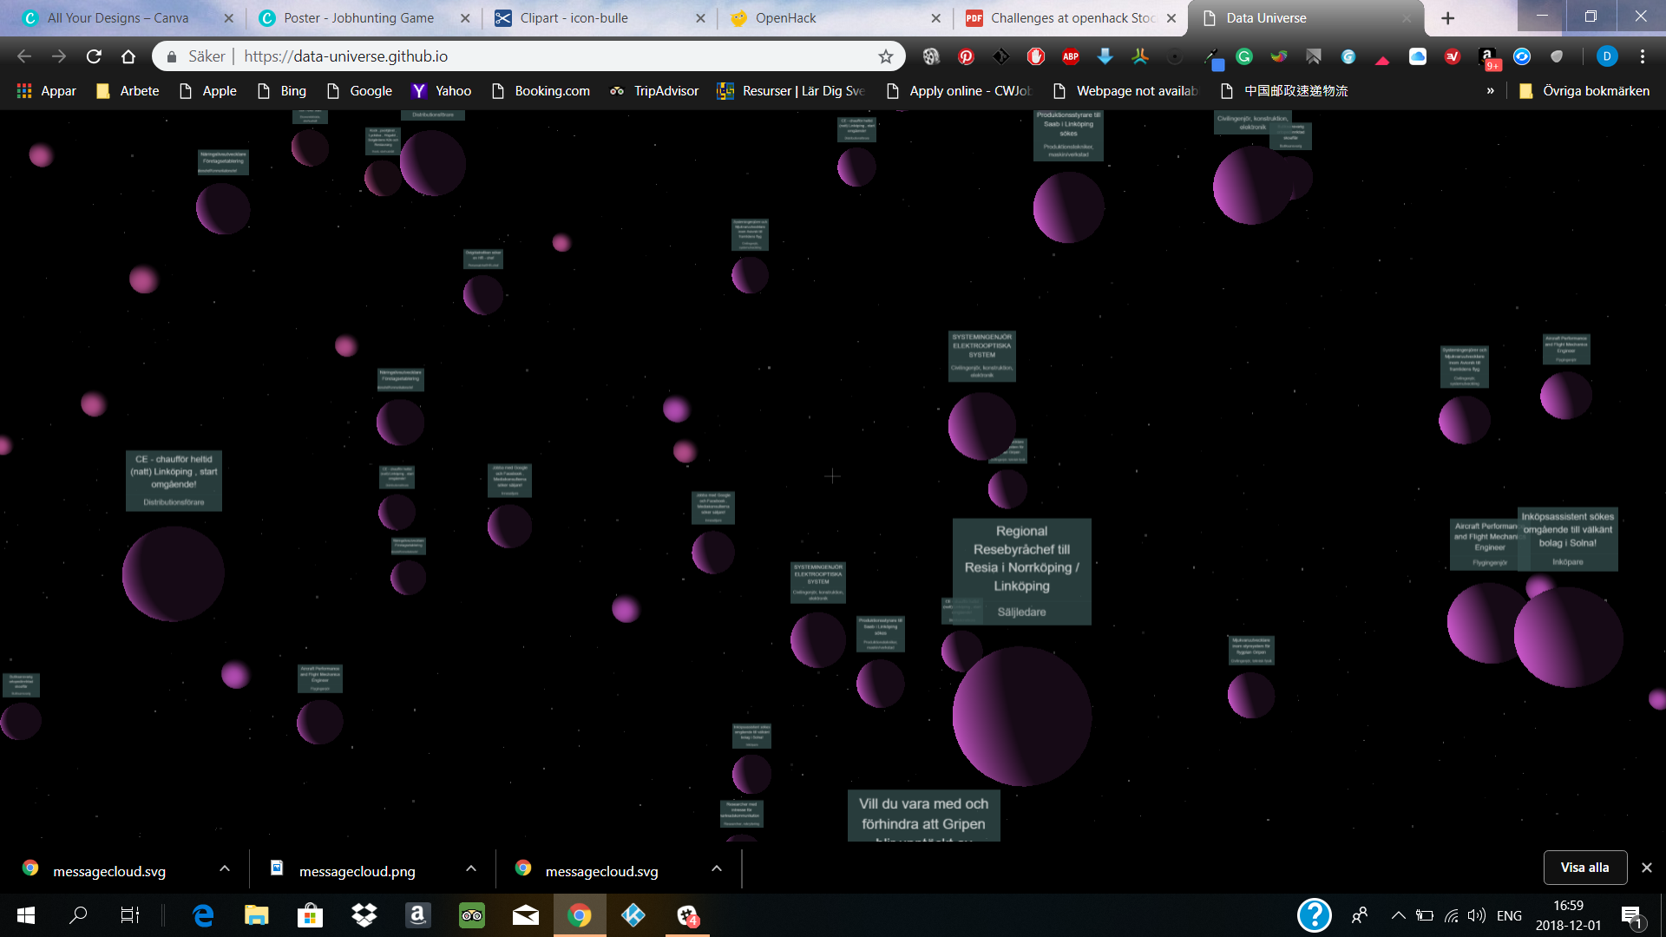
Notes:
This is data universe, a great visualization created in a previous OpenHack. Can it be improved? There are some things that could be different. What if each planet represented a specific job field and not one distinct job? Let’s start from that and suppose that the user clicks on that planet.

Slide 3
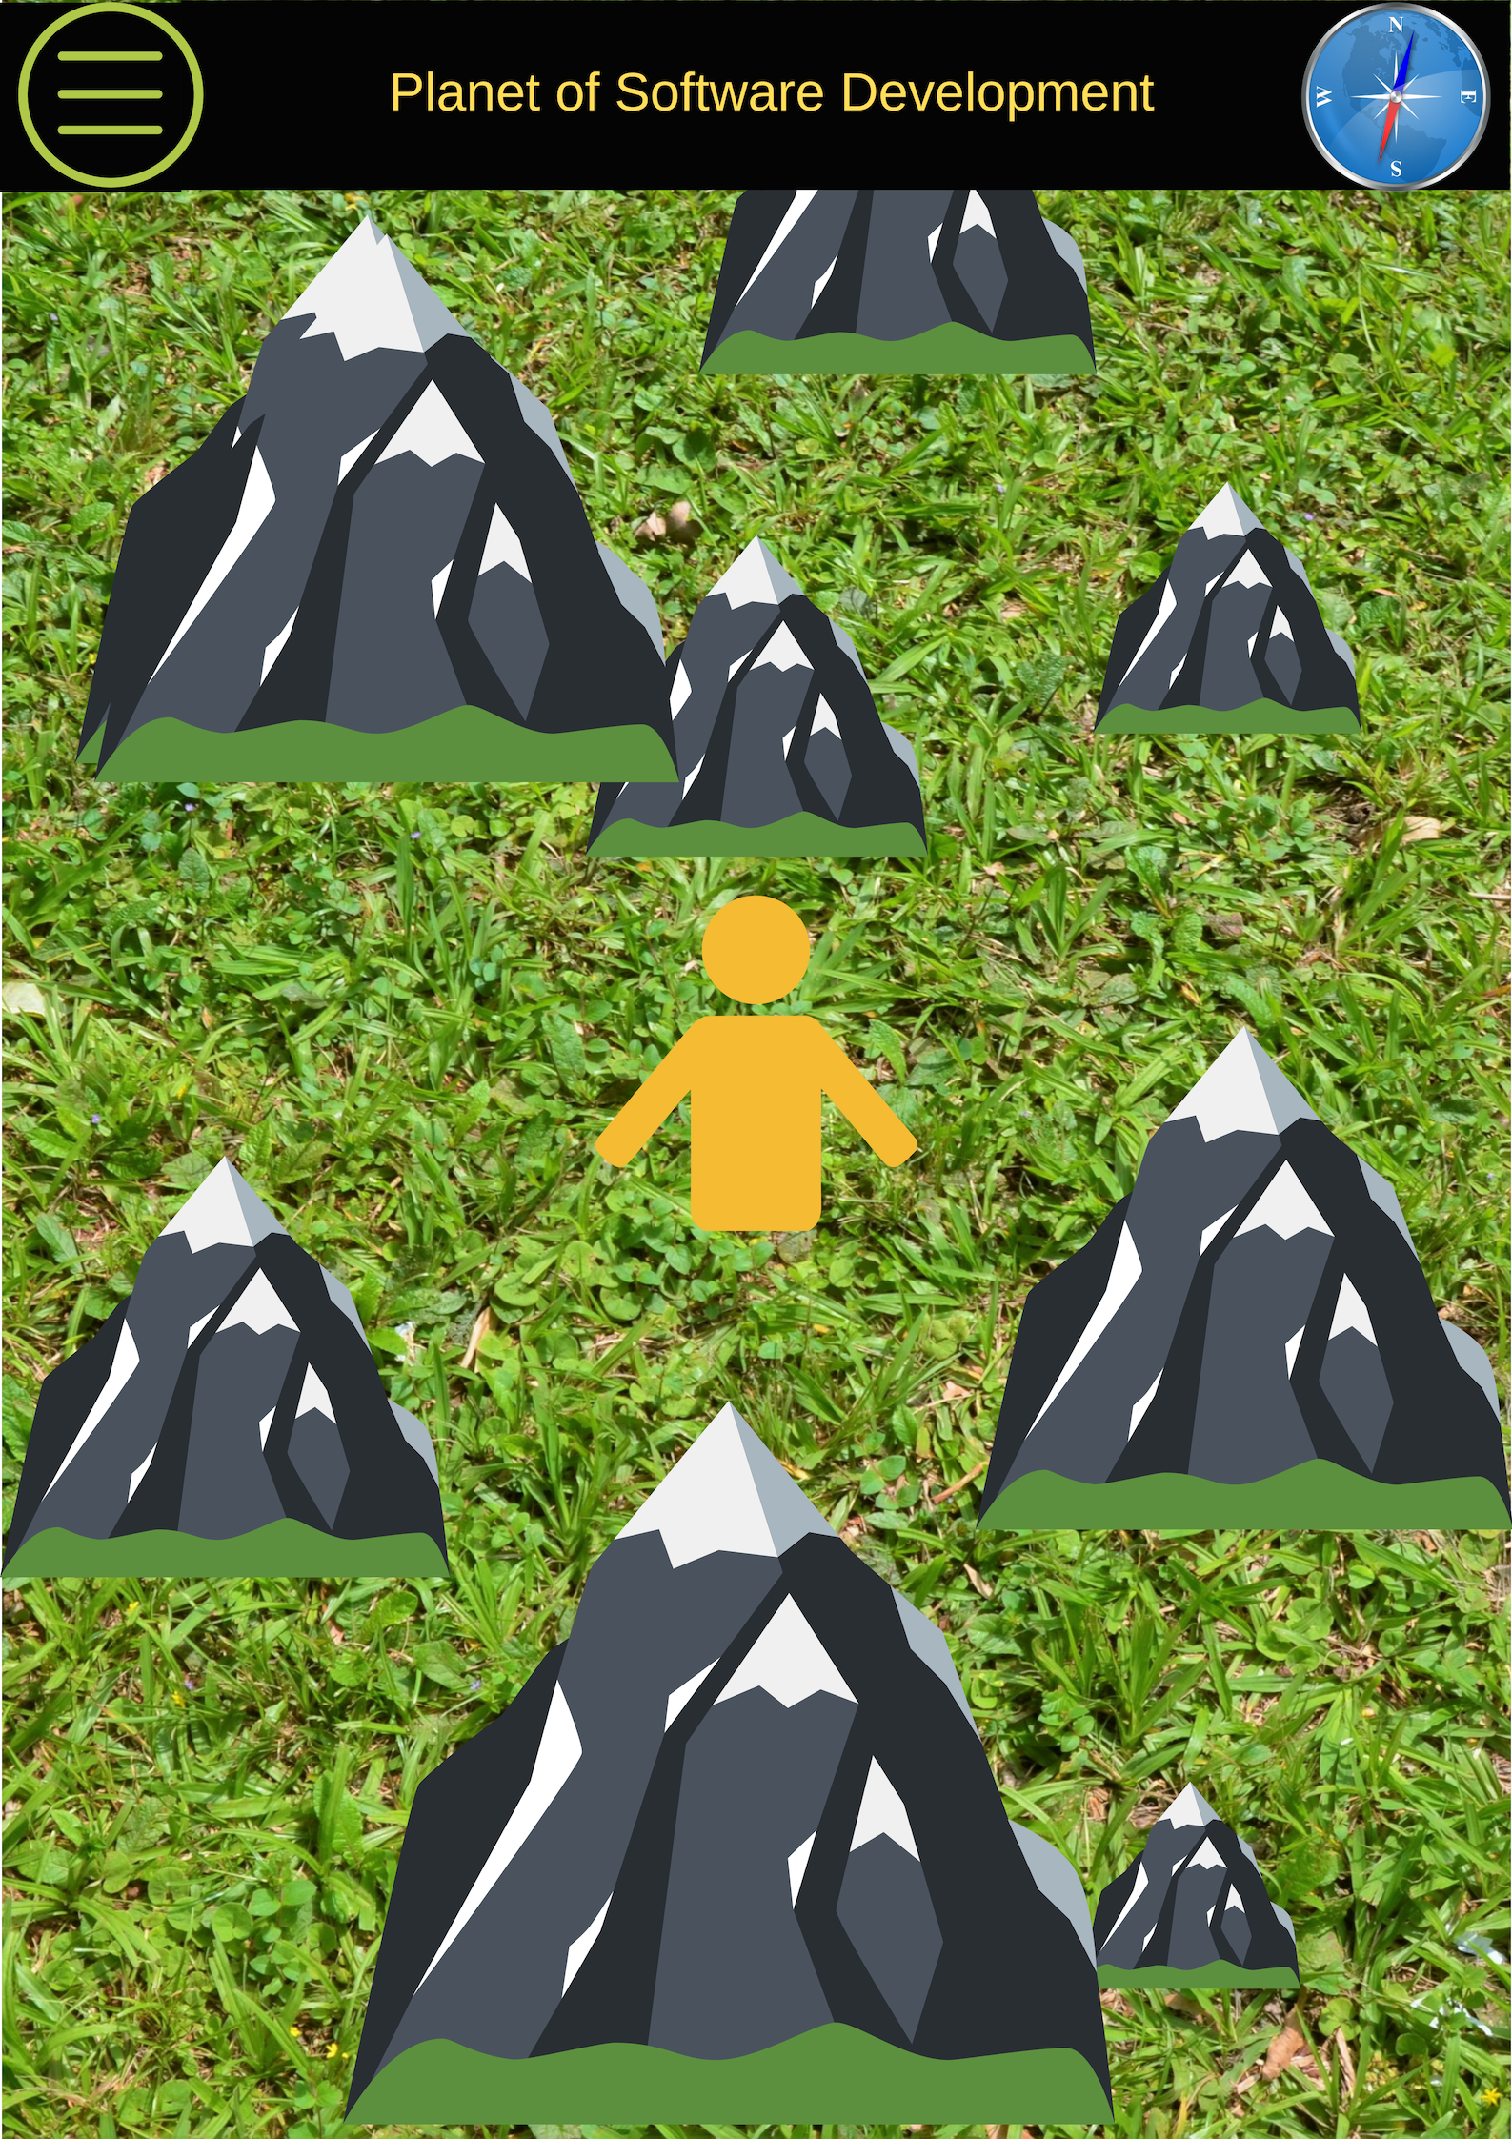
Welcome to the planet of the Software Development where anything is possible!!
Notes:
When the user selects the job area, a North Up display of the locations of relevant jobs appear all around as high mountains or not so high hills. Their height corresponds to the degree of matching difficulty, meaning that a low hill is a better match and perhaps an easier to get job. So, without any other reference, the user tries first to climb the lowest heights. And that’s where all the fun begins.

Slide 4
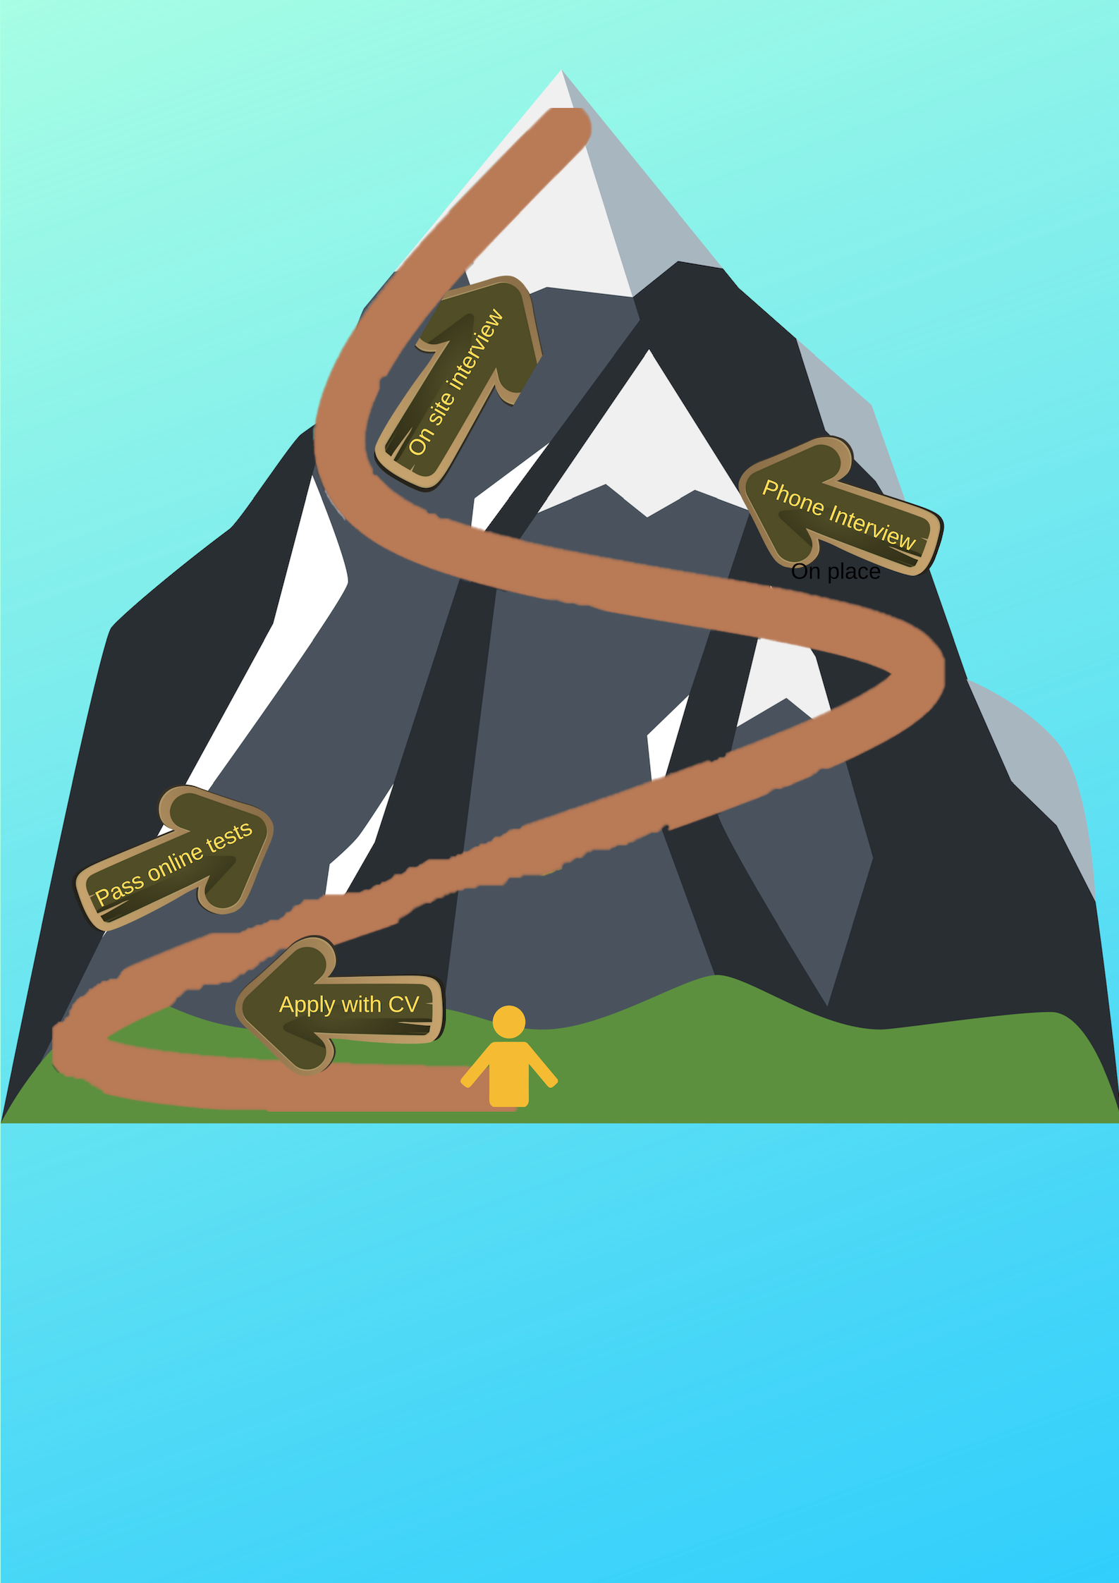
Hackersoft LTD
– Web Developer
– Full time
– Driving Licence Required.

Slide 5
User gets the important information not only about the job but also about the application process!
Hackersoft LTD
– Web Developer
– Full time
– Driving Licence Required.

Slide 6
User gets the important information not only about the job but also about the application process!
The first step is there, the users takes it and the handler at the Unemployment Office is immediately informed.
”Send CV – Check!”
Hackersoft LTD
– Web Developer
– Full time
– Driving Licence Required.

Slide 7
User gets the important information not only about the job but also about the application process!
The first step is there, the users takes it and the handler at the Unemployment Office is immediately informed.
”Send CV – Check!”
As soon as an answer has been received by the potential employer, the handler is again informed by the job seeker.
Hackersoft LTD
– Web Developer
– Full time
– Driving Licence Required.
Notes:
If the answer is negative, the mountain ”disapppears” from the map. On the other hand , if the user is invited for the next step....

Slide 8
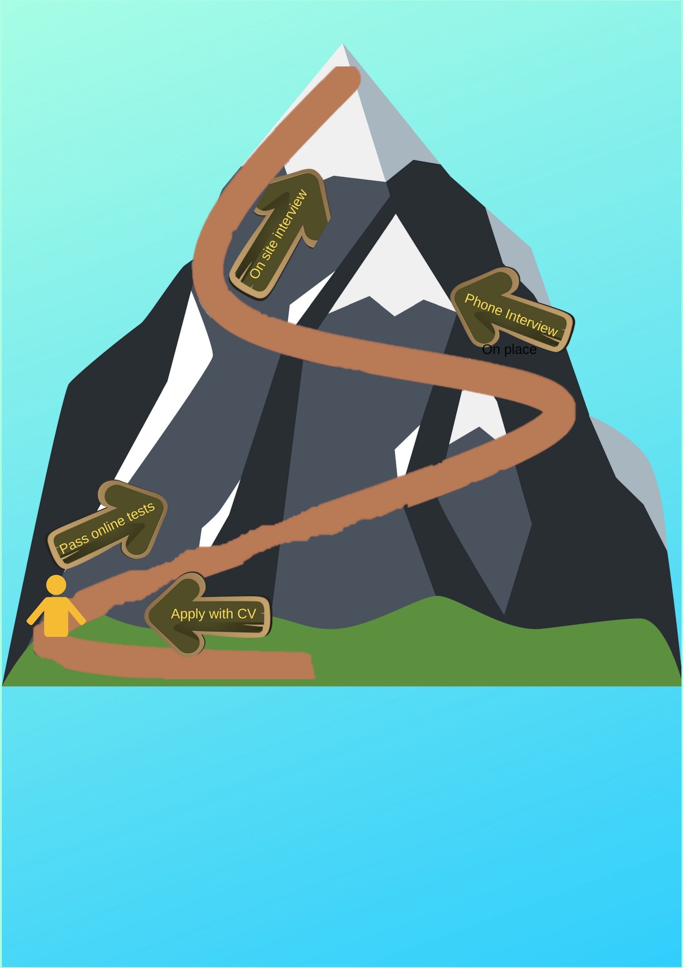
Next time the user tries to ”climb” this mountain, part of the path has already been walked and the peak is closer... Great motivation for taking the next step.
And so it’s done.
Hackersoft LTD
– Web Developer
– Full time
– Driving Licence Required.

Slide 9

The user is already half way there! The peak is even closer and the next step is more exciting than ever.
Hackersoft LTD
– Web Developer
– Full time
– Driving Licence Required.

Slide 10
The user is already half way there! The peak is even closer and the next step is more exciting than ever.
Now the user knows:
Each step taken...
Hackersoft LTD
– Web Developer
– Full time
– Driving Licence Required.

Slide 11
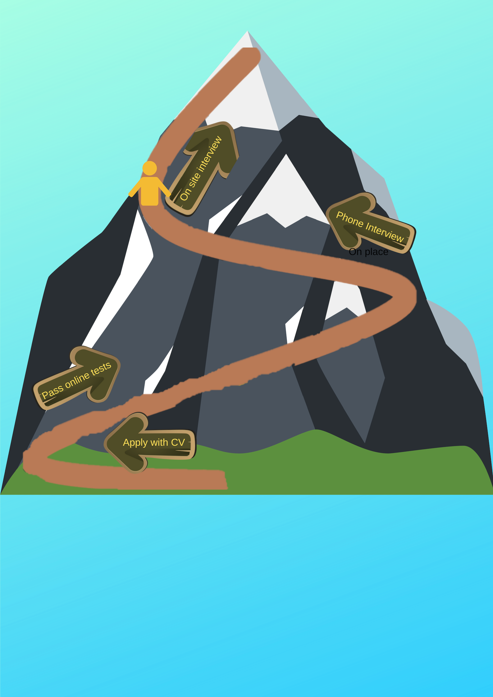
...brings the peak closer and closer until...
Hackersoft LTD
– Web Developer
– Full time
– Driving Licence Required.

Slide 12
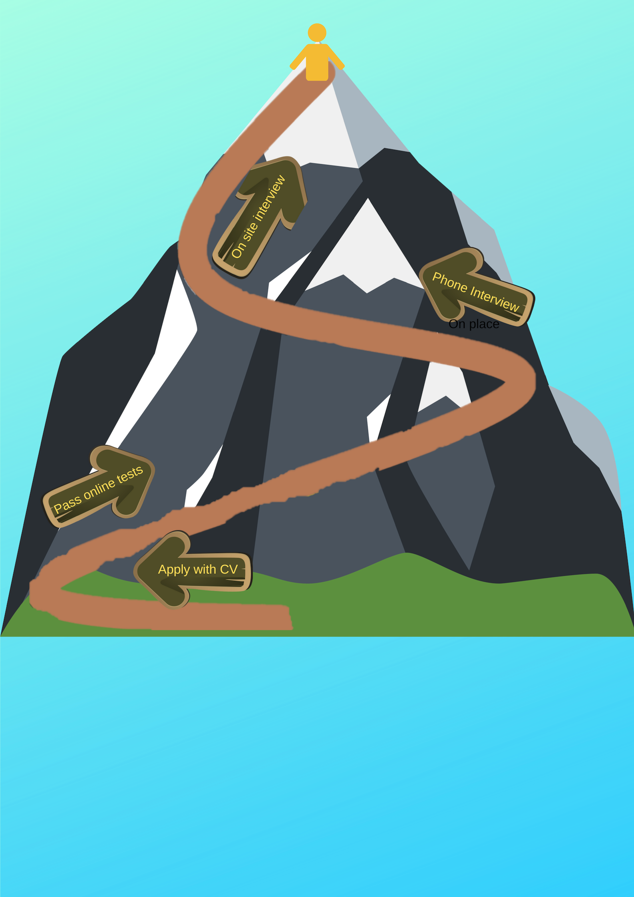
... the peak has finally been conquered and a nice job begins from Monday!!!!
Hackersoft LTD
– Web Developer
– Full time
– Driving Licence Required.

Slide 13


